Slide 1
Data Governance Simulation Project
Automated Python Dashboard + PIPEDA Compliance + Cloud Migration
By,
Naufiya Rasheed

Slide 2
Project Overview
Simulated a full data governance workflow using Python
Goal: Detect violations, monitor quality, and evaluate cloud readiness
Tools: Python, Pandas, Seaborn, Plotly Dash, Jupyter Notebook
Automated dashboard created to visualize key governance metrics

Slide 3
Datasets Used (100+ Records)
1. tagged_catalog.csv – Metadata classification (PII, Financial, etc.)
2. data_quality_report.csv – Nulls, duplicates, invalid values
3. cloud_migration_report.csv – Migration readiness & encryption flags
4. pipeda_violations.csv – Employee access logs and policy breaches

Slide 4
Governance Processes Simulated
Data Cataloging & Classification (PII, Financial, General)
PIPEDA Compliance Audit (flag unauthorized access by interns/analysts)
Data Quality Checks (nulls, duplicates, invalid values)
Cloud Migration Simulation (encryption & eligibility check)

Slide 5
Power BI-style Dashboard (Using Dash)
Visualized data classification, quality issues, cloud readiness
PIPEDA violations table with roles, datasets, and flags
Fully interactive dashboard built in Dash (Python)
Auto-refresh and scalable to new data drops

Slide 6
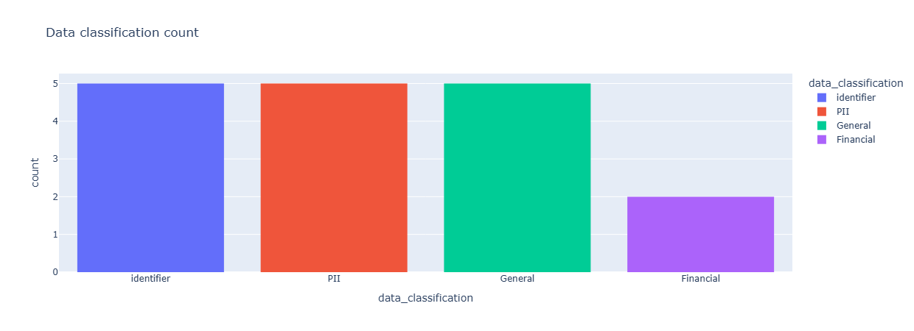
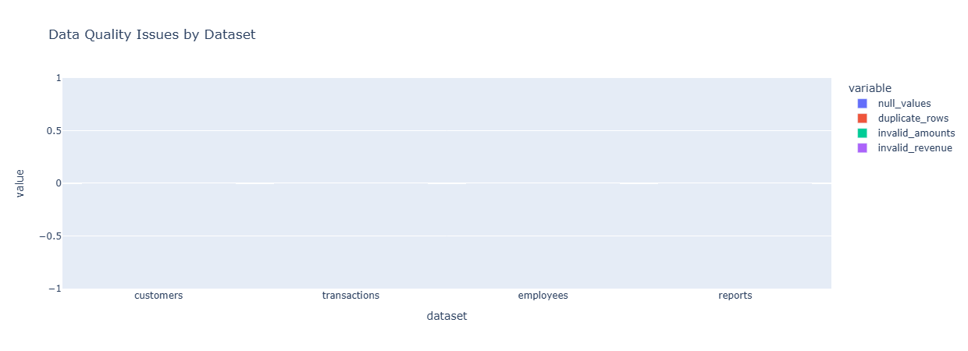

Slide 7
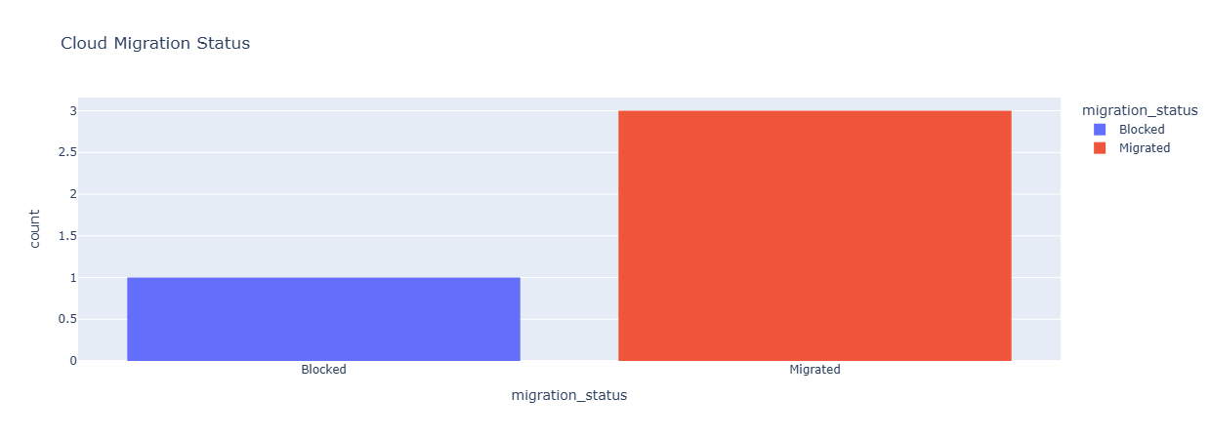
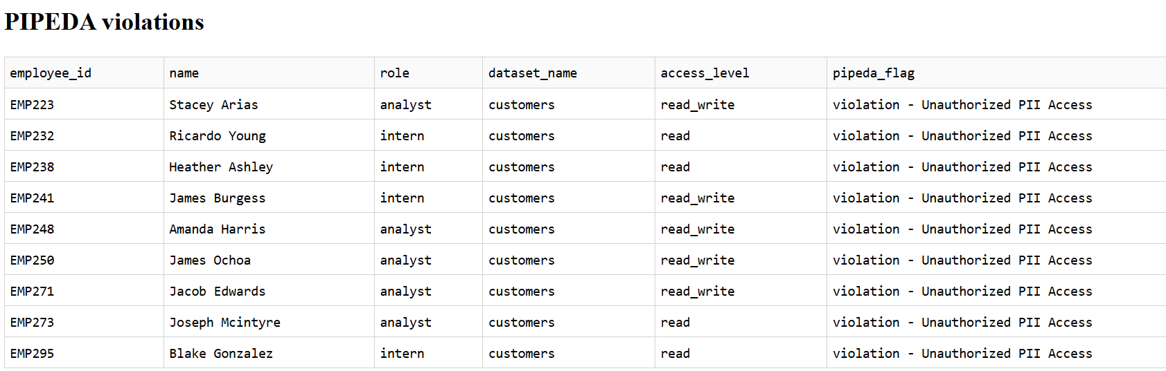

Slide 8
Automation: Run Anywhere
Script `data_governance_dashboard.py` launches dashboard
Auto-generated CSVs and visuals via Jupyter & Python
Optional `.bat` or `.sh` file to auto-launch the dashboard
Dashboard viewable on browser: `http://localhost:8050`

Slide 9
Outcomes & Learning
Built real-world data governance logic into code
Created complete data lineage from tagging to violation detection
Delivered automated, interactive dashboard for compliance review
Gained hands-on skills with Dash, Pandas, Plotly, and automation

Slide 10
Thankyou

